Slide 1
CoffeeScript is For Closers
Brandon Satrom
@BrandonSatrom
UserInExperience.com

Slide 2

Put the Coffee(Script) Down! Coffee(Script) is for Closers!

Slide 3
Or…
JavaScript, Linguistics and Cockney Rhyming Slang

Slide 4
Or…
How CoffeeScript Made me a Better JavaScript Developer

Slide 5
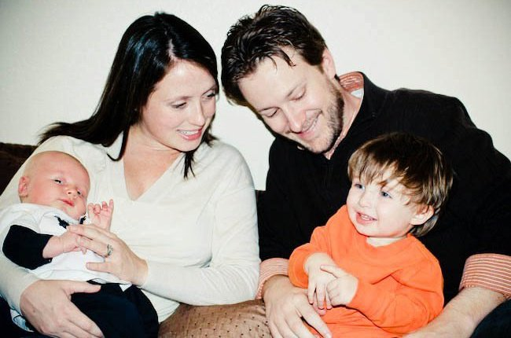
So Who Am I?
Husband and Father
Web Developer & Evangelist, Microsoft
Austin, TX
www.userinexperience.com
@BrandonSatrom
github.com/bsatrom

Slide 6
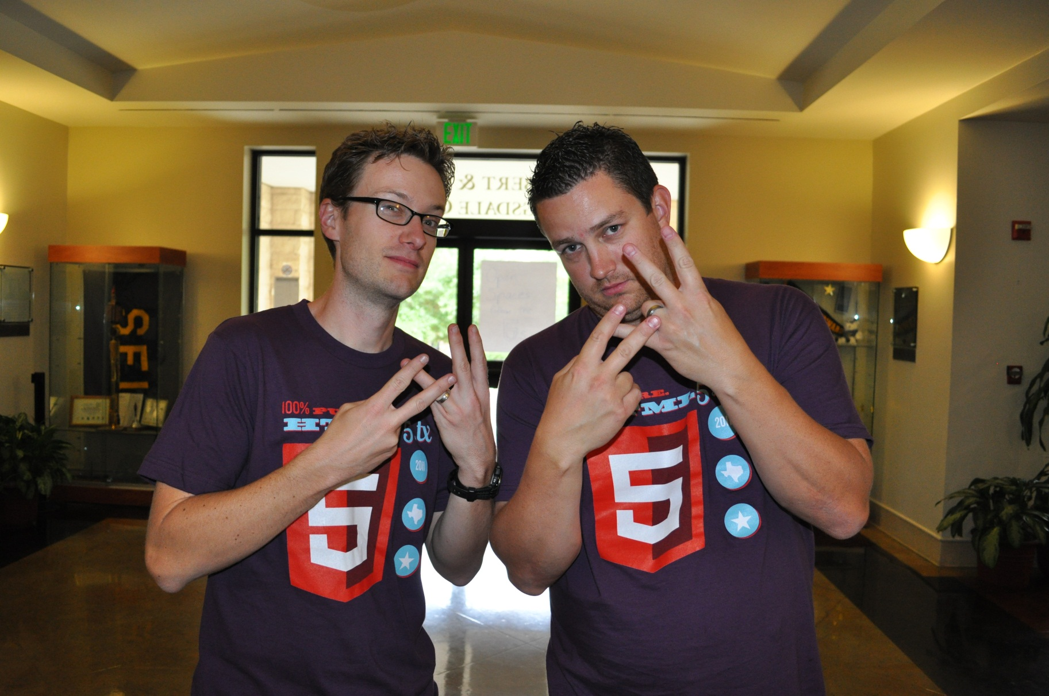
#html5tx

Slide 7
Agenda
The JavaScript Dialectic
What?
Where?
How?
Why?

Slide 8


VS.

Slide 9
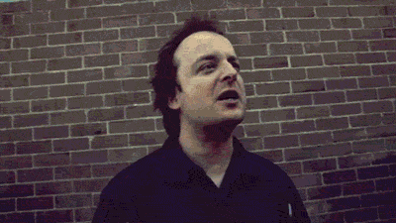
A JavaScript Dialectic

Slide 10


Don’t Be A JavaScriptster
I loved JavaScript before it was cool
Of course, I also hated it back when everyone else did too…

Slide 11

Don’t Be A CoffeeScriptster
JavaScript is lame! Significant Whitespace FTW!
Let’s hope they don’t notice that I still debug in JavaScript…

Slide 12
What?
What is CoffeeScript?

Slide 13
“It’s Just JavaScript”
Or “Unfancy JavaScript”

Slide 14
“A polyglot language”
A Ruby, Haskell and Perl love child…

Slide 15
“A little language”
Meaning…it’s not DART

Slide 16
Transpiler vs. Compiler
Transpiled Languages
Compiled Languages
CoffeeScript
Traceur
EcmaScript 5 Parser
Reflect.js
DART
GWT
Objective-J
ClojureScript
JSIL
Script#
Emscripten
Haxe
LIAR!

Slide 17
More A Dialect, Less A Language
Color === Colour
function(foo) {} === (foo) ->

Slide 18
Subtle Linguistics
Dave has two children. His youngest is in Reception, and his favourite colour is green. His oldest is Year 4, and loves to ride the lift outside his flat.
Dave has two children. His youngest is in Pre-K, and his favorite color is green. His oldest is in 3rd Grade, and he loves to ride the elevator outside his apartment.

Slide 19
Not so subtle linguistics…
Sentence | Extended Phrase | Rhymes With
I’ve got a sore billy. | Billy Goat | Throat
That’s a nasty old boris you’ve got there son. | Boris Karloff | Cough
Ere, you’ve got your brass wrong! | Brass Tacks | Facts
‘ow about a Brittney? | Brittney Spears | Beers
We’re all in Barney! | Barney Rubble | Trouble
Think he’s been smoking a bit of Bob | Bob Hope | (you get the idea)

Slide 20
CoffeeScript is not a replacement for Learning JavaScript
CoffeeScript Axiom #1

Slide 21
Compiles 1:1 to JavaScript
1:1 being Concept to Concept

Slide 22
Conceptual Equivalence
CoffeeScript
JavaScript
numbers = [1..10]
printNum = (number) ->
console.log "This is number #{number}"
printNum for num in numbers
var num, numbers, printNum, _i, _len;
numbers = [1, 2, 3, 4, 5, 6, 7, 8, 9, 10];
printNum = function(number) {
return console.log("This is number " + number);
};
for (_i = 0, _len = numbers.length; _i < _len; _i++) {
num = numbers[_i];
printNum;
}

Slide 23
Conceptual Equivalence
CoffeeScript
JavaScript
numbers = [1..10]
printNum = (number) ->
console.log "This is number #{number}"
printNum num for num in numbers
var num, numbers, printNum, _i, _len;
numbers = [1, 2, 3, 4, 5, 6, 7, 8, 9, 10];
printNum = function(number) {
return console.log("This is number " + number);
};
for (_i = 0, _len = numbers.length; _i < _len; _i++) {
num = numbers[_i];
printNum(num);
}

Slide 24
Conceptual Equivalence
CoffeeScript
JavaScript
numbers = [1..10]
printNum = (number) ->
console.log "This is number #{number}"
printNum num for num in numbers
var num, numbers, printNum, _i, _len;
numbers = [1, 2, 3, 4, 5, 6, 7, 8, 9, 10];
printNum = function(number) {
return console.log("This is number " + number);
};
for (_i = 0, _len = numbers.length; _i < _len; _i++) {
num = numbers[_i];
printNum(num);
}

Slide 25
Conceptual Equivalence
CoffeeScript
JavaScript
numbers = [1..10]
printNum = (number) ->
console.log "This is number #{number}"
printNum num for num in numbers
var num, numbers, printNum, _i, _len;
numbers = [1, 2, 3, 4, 5, 6, 7, 8, 9, 10];
printNum = function(number) {
return console.log("This is number " + number);
};
for (_i = 0, _len = numbers.length; _i < _len; _i++) {
num = numbers[_i];
printNum(num);
}

Slide 26
Where?
Where do I get it?

Slide 27
Ways to Get CoffeeScript
node.js & npm
Script Tags
<script type=“text/coffeescript”></script>
<script src=“coffee-script.js”></script>
Rails 3.1
SassAndCoffee (.NET)
CoffeeScript Packages
$ npm install –g coffee-script

Slide 28

Tools for CoffeeScript
IDE Extensions/Plugins
Asset Pipeline Tools
Live Debugging/Preview
See more at http://bit.ly/nx6JGo

Slide 29
How?
How can I use, learn and automate it?

Slide 30
REPL
$ coffee
coffee> [1..10]

Slide 31
COMPILE
$ coffee –o js/ -cw lib/

Slide 32
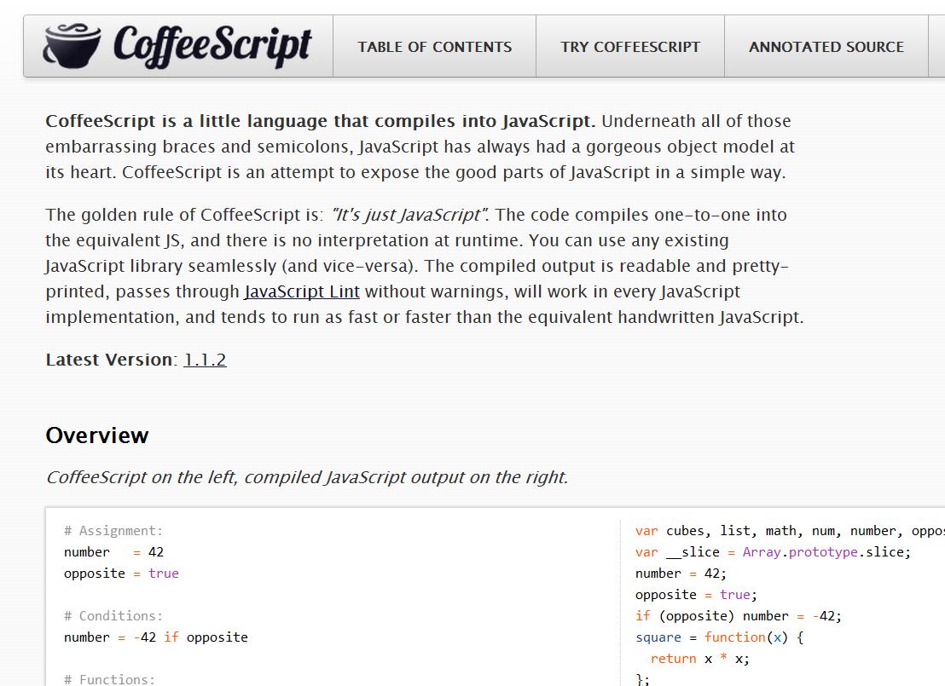
CoffeeScript Basics

Slide 33
Assignment
name = “Brandon”
married = yes
children = 2
var children, married, name;
name = "Brandon";
married = true;
children = 2;

Slide 34
Functions
square = (x) -> x * x
printInfo = (name, numChildren) ->
“Hi #{name}, I see you have #{numChildren} children.”
var printInfo, square;
square = function(x) {
return x * x;
};
printInfo = function(name, numChildren) {
return "Hi " + name + ", I see you have " + numChildren + " children";
};

Slide 35
Strings
num = 99
“I’ve got #{num} problems, and JavaScript ain’t one.”
city = "Brooklyn"
"No. Sleep. 'Till. #{city}"
var city, num;
num = 99;
"I've got " + num + " problems, but JavaScript ain't one";
city = "Brooklyn";
"No. Sleep. 'Till. " + city;

Slide 36
Objects
kids =
bigBrother:
name: “Benjamin”
age: 2
littleBrother:
name: “Jack”
age: 1
var kids;
kids = {
bigBrother: {
name: “Benjamin”,
age: 2
},
littleBrother: {
name: “Jack”,
age: 1
}
};

Slide 37
Lexical Scoping
outer = 42
findMeaning = ->
inner = 43
outer
inner = findMeaning()
var findMeaning, inner, outer;
outer = 42;
findMeaning = function() {
var inner;
inner = 43;
return outer;
};
inner = findMeaning();

Slide 38
Lexical Scoping 2
notGlobal = "Hello"
global = "Goodbye"
window.global = global
(function() {
var global, notGlobal;
notGlobal = "Hello";
global = "Goodbye";
window.global = global;
}).call(this);

Slide 39
Everything, an Expression
grade = (student) ->
if student.excellentWork
"A+"
else if student.okayStuff
if student.triedHard then "B" else "B-"
else
"C"
eldest = if 24 > 21 then "Liz" else "Ike"
var eldest, grade;
grade = function(student) {
if (student.excellentWork) {
return "A+";
} else if (student.okayStuff) {
if (student.triedHard) {
return "B";
} else {
return "B-";
}
} else {
return "C";
}
};
eldest = 24 > 21 ? "Liz" : "Ike";

Slide 40
Conditionals
mood = greatlyImproved if singing
if happy and knowsIt
clapsHands()
chaChaCha()
else
showIt()
lunch = if friday then water else redBull
options or= defaults
var lunch, mood;
if (singing) {
mood = greatlyImproved;
}
if (happy && knowsIt) {
clapsHands();
chaChaCha();
} else {
showIt();
}
lunch = friday ? water : redBull;
Options || (options = defaults);

Slide 41
Operators and Aliases
CoffeeScript | JavaScript
is, == | ===
isnt, != | !==
not | !
and | &&
or | ||
true, yes, on | true
false, no, off | false
@, this | this
of | in
in | no equivalent

Slide 42
How I Use CoffeeScript
Let’s pretend for a moment that how I use it, matters.

Slide 43
Coffee, Cake and Growl
Cake (think Make or Rake)
‘watch’ Task
wingrr (use node-growl for *nix)
invoke 'build'
invoke 'tests'
msg = 'All test pass'
sys.puts msg.green
wingrr.notify msg

Slide 44
Why?
Why should I bother using it?

Slide 45
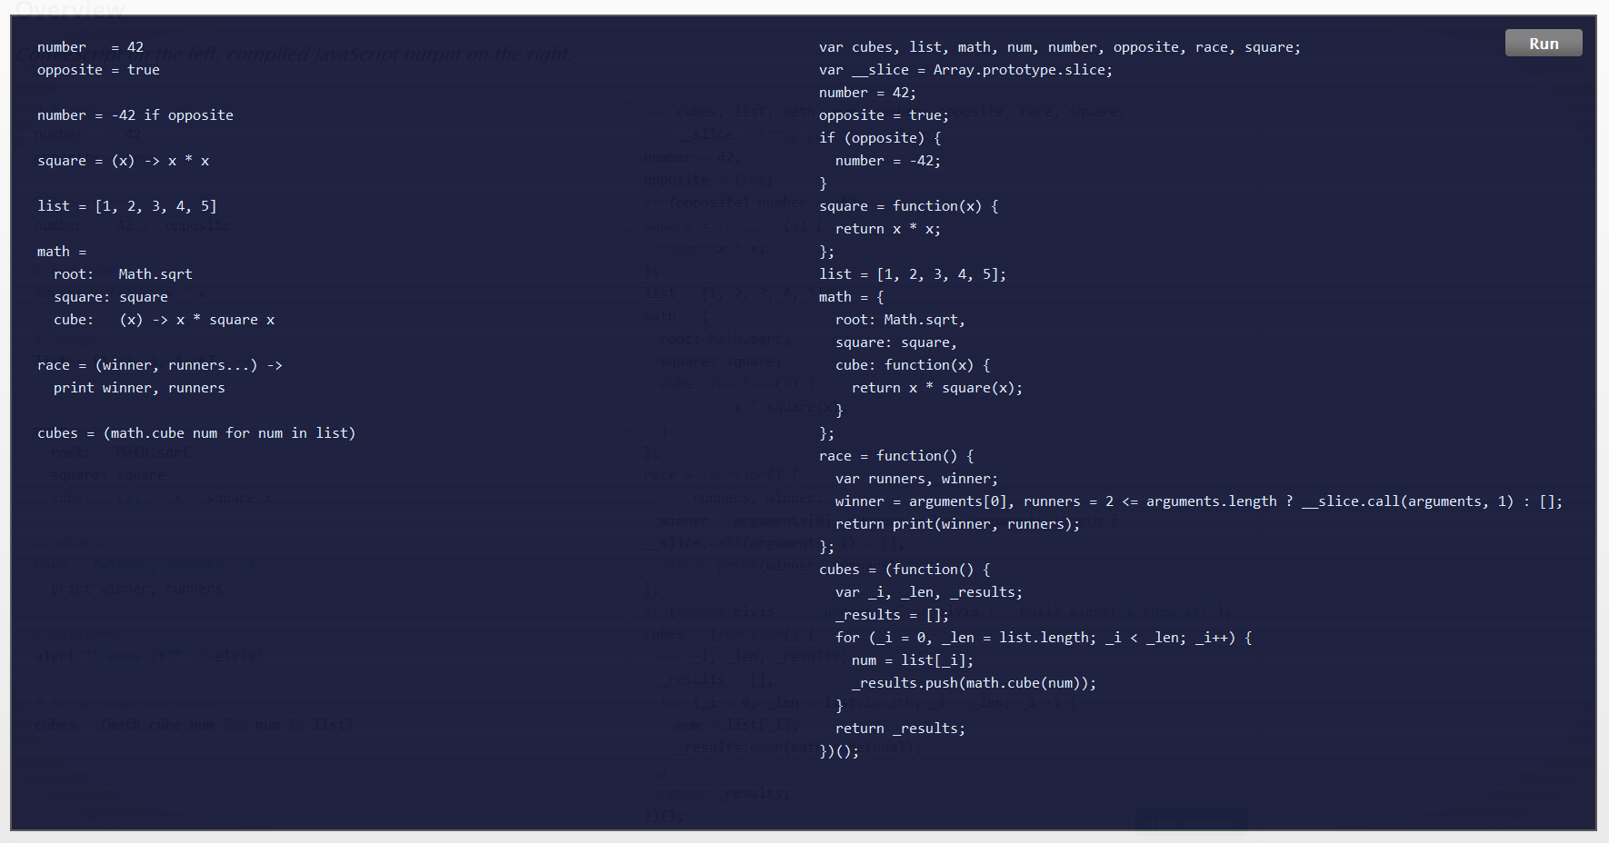
Pro
More succinct code

Slide 46
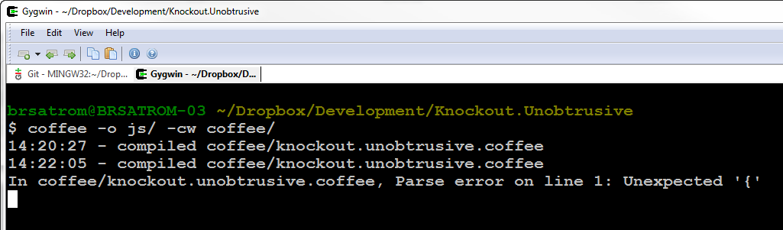
Con
Extra compile step between you and the “real” code

Slide 47
Pro
hi == bye
global = "everywhere?"
switch day
when "Fri", "Sat"
if day is bingoDay
go bingo
go dancing
when "Sun" then go church
else go work
(function() {
var global;
hi === bye;
global = "everywhere?";
switch (day) {
case "Fri":
case "Sat":
if (day === bingoDay) {
go(bingo);
go(dancing);
}
break;
case "Sun":
go(church);
break;
default:
go(work);
}
})();
Avoid Snake Pits & Get JS Patterns for Free

Slide 48
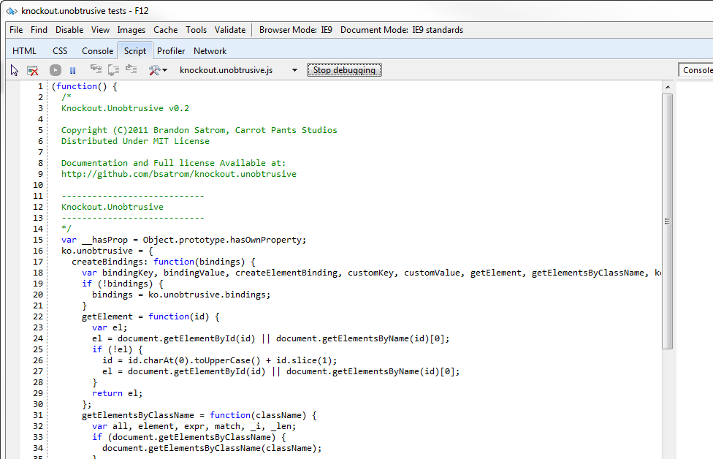
Con
Errors and Debugging: it’s still JavaScript in there

Slide 49
Pro
Conjecture!
As fast or faster JavaScript

Slide 50
Con
Code Generation(?)!
Dare I say it? Code Generation!

Slide 51

Ok, CoffeeScript is Opinionated
Shirts are for n00bs…
Like all software is…

Slide 52

With Apologies to the Ninjas

Slide 53
The Five Stages of JavaScript
Avoidance
Concession
Abstraction
Failure
Enlightenment

Slide 54
arr = new Array(4, 8, 15, 16);
arr[4] = 23;
arr[5] = 42;
for (i = 0; i < arr.length; i++)
{
enterLottoNum(arr[i]);
}

Slide 55
var arr = [4, 8, 15, 16, 23, 42];
for (var i = 0; i < arr.length; i++) {
enterLottoNum(arr[i]);
}

Slide 56
var arr, num, _i, _len;
arr = [4, 8, 15, 16, 23, 42];
for (_i = 0, _len = arr.length;
_i < _len; _i++) {
num = arr[_i];
enterLottoNum(num);
}

Slide 57
CoffeeScript made me want to be
a better man
JavaScript
Programmer

Slide 58
CoffeeScript can help you become a better JavaScript programmer
CoffeeScript Axiom #2
Notes:
So that brings me to Axiom #2. Books and online resources are great, but I would argue that using CoffeeScript is another way to become a better JavaScript developer. I am actually spinning that it generates JS for you as a good thing. I personally learned a lot in the process.
And this, for me, is only true because you still have to debug the JavaScript that CoffeeScript creates.

Slide 59
But there’s nothing wrong with JavaScript!

Slide 60


Slide 61
Influencing JS.Next
let name = “block scoped!"
const REALLY = "srsly"
#add(a, b) { a + b }
module Mod {
export const K = “foo”
export #add(x, y) { x + y }
}
Function
Declaration!

Slide 62
Whither JavaScript?
“The only thing that has happened when new languages pop up is that JavaScript gets better.”
– Chris Williams

Slide 63
JavaScript Gets Better
JavaScript
jQuery, et al.
ECMAScript 5
CoffeeScript
Harmony/JS.Next
?

Slide 64
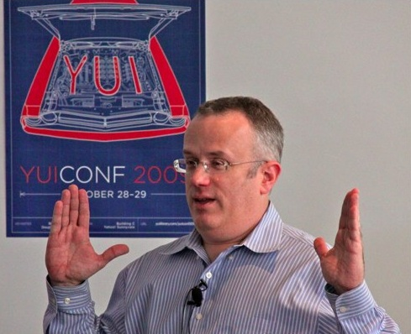
It’s not a replacement for JavaScript
"We are not just advocating a language on top of JS that you use to avoid JS (GWT, Haxe, Objective-J, etc.). We are advocating that you all help build a better JS on JS, which then becomes standardized as JS.next." - Brendan Eich
CoffeeScript Axiom #3

Slide 65
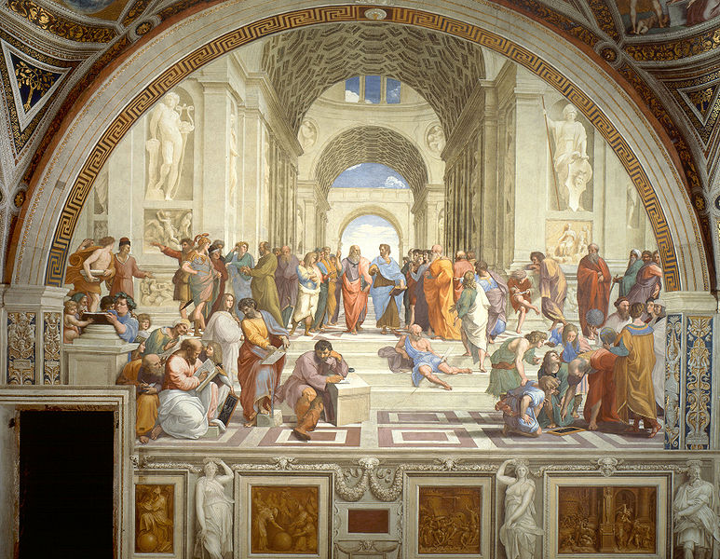
the JavaScript Dialectic, Revisited
What Can I/We/Everyone Learn from CoffeeScript?

Slide 66
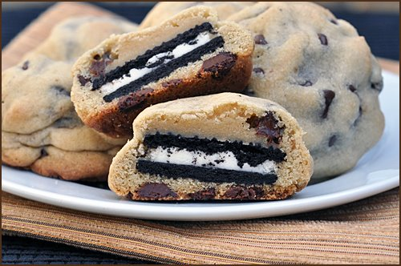
Those Axioms
1) It’s not a replacement for learning JavaScript
2) It can help you become a better JavaScript programmer
3) It’s not a replacement for JavaScript

Slide 67
Resources - http://bit.ly/...
Slides - pLWIMf
CoffeeScript Website - nfWYwn
Annotated Source - qdAXfn
CoffeeScript Koans - o1K6bL
Smooth CoffeeScript Book - nI7GEU
Jeremy & Brendan @ JSConf 2011 - o9KieZ
“Harmony of my Dreams” - mQkdtp
Notes:
CoffeeScript Website - http://jashkenas.github.com/coffee-script/
CoffeeScript Annotated Source - http://jashkenas.github.com/coffee-script/documentation/docs/grammar.html
CoffeeScript Koans - https://github.com/sleepyfox/coffeescript-koans
Smooth CoffeeScript Book - http://autotelicum.github.com/Smooth-CoffeeScript/
Jeremy and Brendan @ JSConf 2011 - http://blip.tv/jsconf/jsconf2011-jeremy-ashkenas-5258082
Bendan’s “Harmony of My Dreams” Post – http://brendaneich.com/2011/01/harmony-of-my-dreams/
Slides for this talk - https://github.com/bsatrom/Presentations/tree/master/CoffeeScript

Slide 68
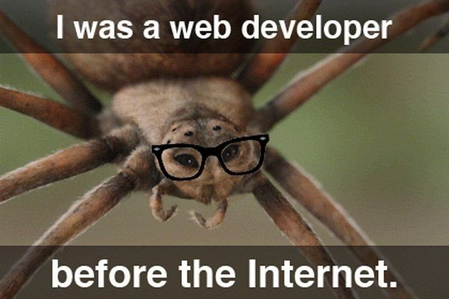
Questions?
@BrandonSatrom
brsatrom@microsoft.com
UserInExperience.com

